Slide 1
HONEY Project
Taylor, Rusul, Richard, Rebecca

Slide 2
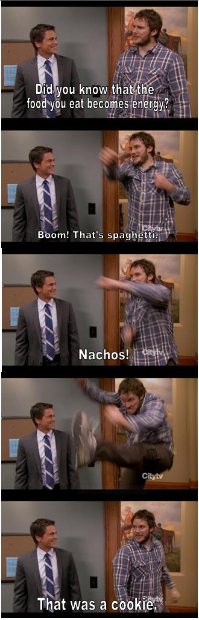
What is Food and what does it do?

Slide 3
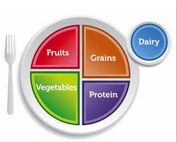
MY PLATE

Slide 4
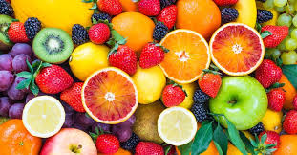
Fruit
Fresh, canned, frozen, dried, pureed and/or 100% fruit juice
Examples
  Bananas, apples. Strawberries, oranges
Fruits have many nutrients
  Potassium, fiber, vitamin C
These things keep us healthy and protect us against disease!

Slide 5
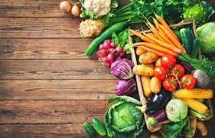
Vegetables
Vegetables may be raw or cooked; fresh, frozen, canned, or dried/dehydrated; and may be whole, cut-up, or mashed or 100% vegetable juice.
Examples
  Broccoli, carrots, cucumber, lettuce
Nutrients
  Potassium, dietary fiber, folate (folic acid), vitamin A, and vitamin C
They help you grow, boost your immune system, and help you fight off disease!

Slide 6
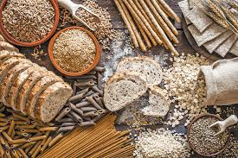
grains
Foods made from wheat, rice, oats, cornmeal, barely, or other cereals.
Examples
  Pasta, bread, rice, cereal, oatmeal, tortillas
Whole Vs. Refined
  Whole - has dietary fiber, B-vitamins, antioxidants
    Ex - brown rice, oatmeal
  Refined - processed, vitamins are added back in, but dietary fiber is not.
    Ex - white rice, white bread
Grains fuel us with energy, make us feel good, and help us digest all the other foods on our plate!

Slide 7
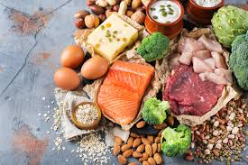
Protein foods
Not just meat!
Protein group includes foods made from
  Meat, poultry, seafood, beans, peas, eggs, soy products, nuts, and seeds.
B-vitamins, iron, zinc
It helps your muscles, gives you energy, and even makes the hormones in your body!

Slide 8
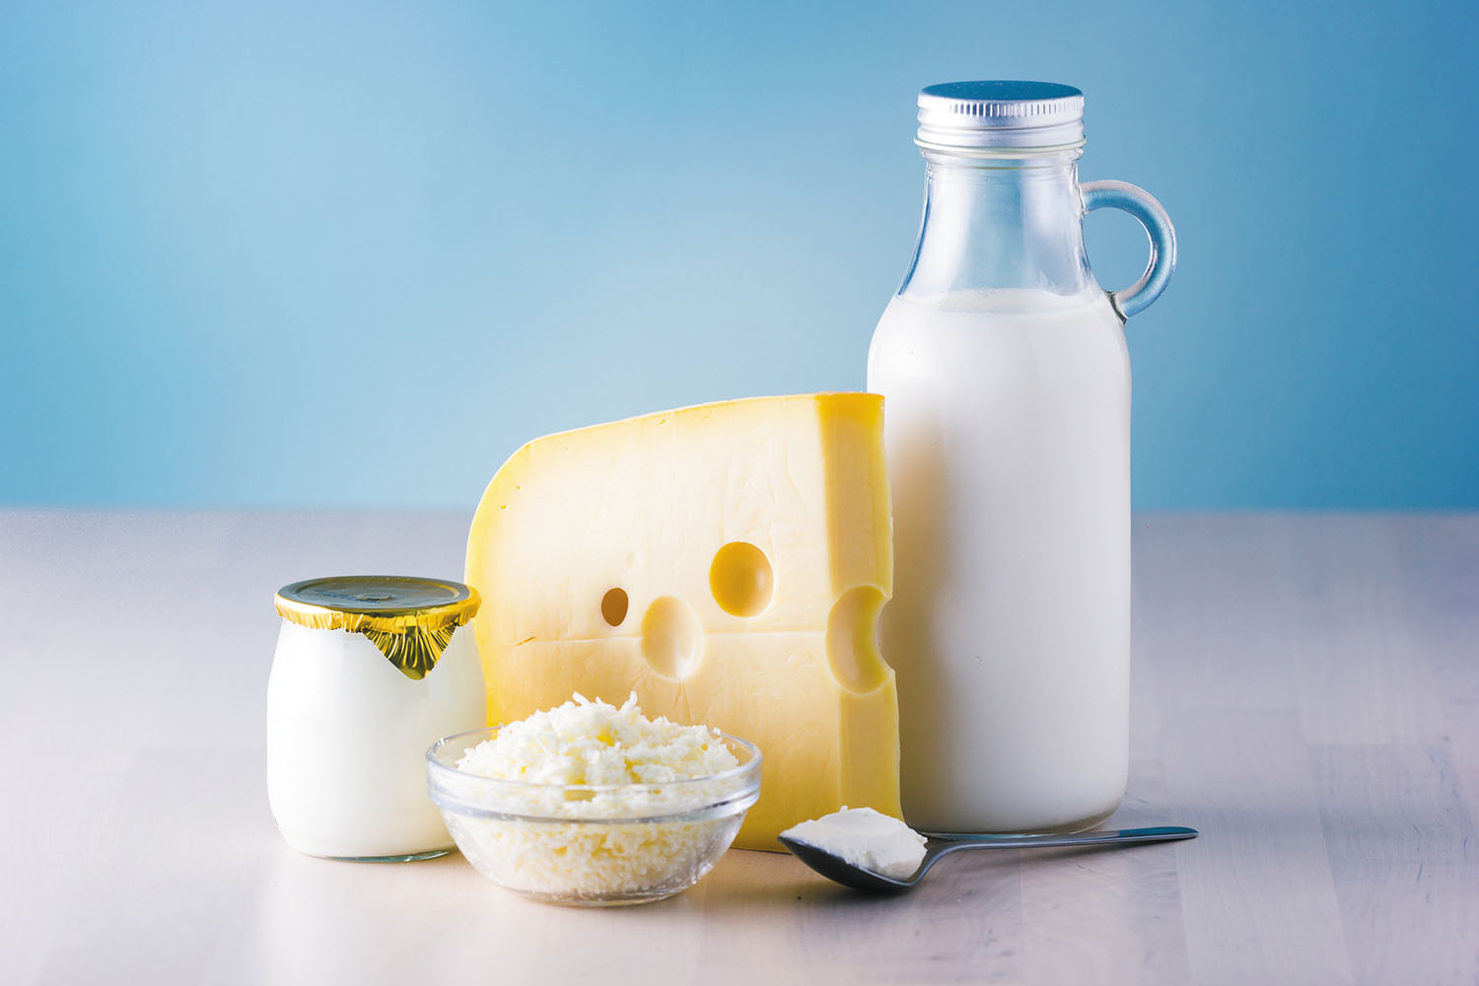
Dairy
Milk or certain products that are made from milk
Examples
  Milk, yogurt
Keeps our bones and teeth strong!
Calcium, potassium, vitamin D

Slide 9
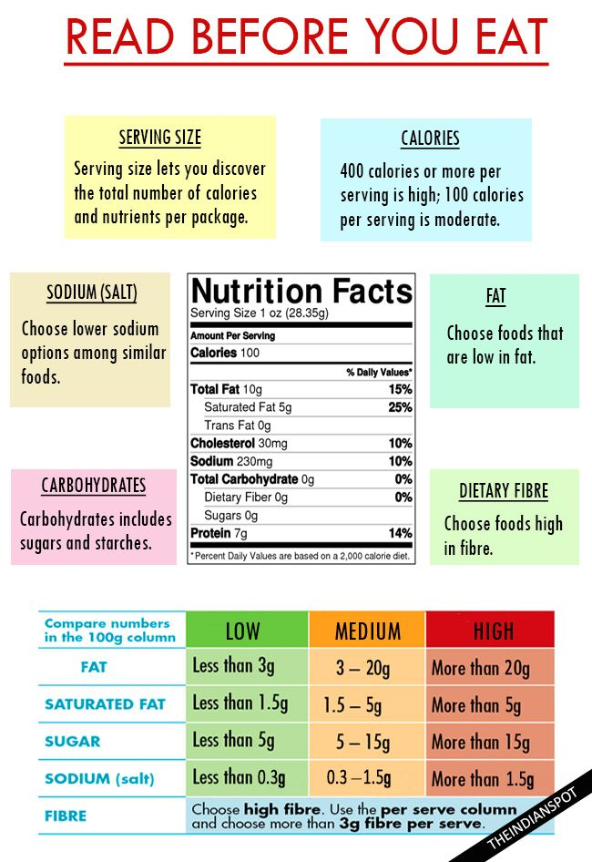
Nutrition Labels
What is Nutrition label :
Tells you how many nutrients are in that amount of food, and always lists a serving size, which is an amount of food Serving sizes also help people understand how much they're eating.
What We need to look at when We read the Nutrition label:
Serving Size
Calories
Nutrients
The percent Daily Values

Slide 10

Nutrition Labels
1.Serving size:
2.

Slide 11
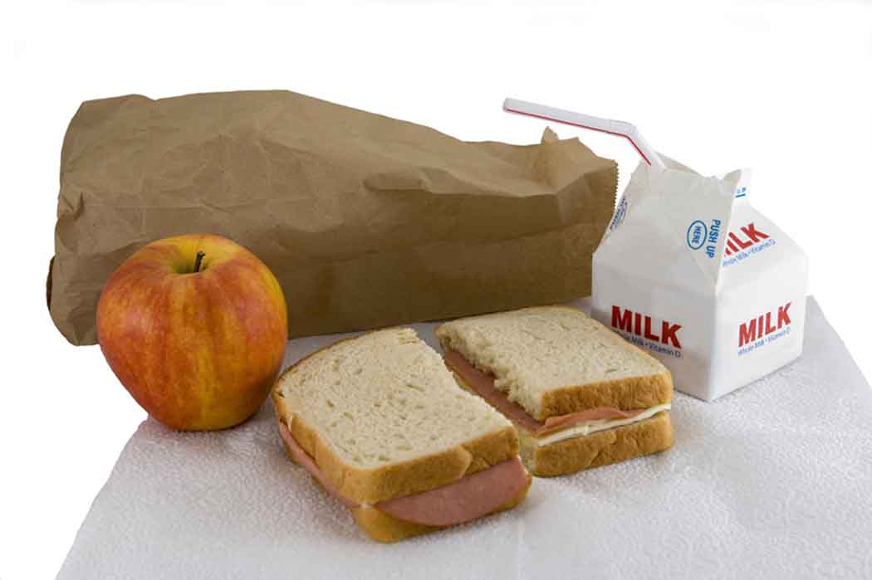
Typical Lunch
Sandwiches
  White bread, lunch meat, cheese slices, peanut butter, jelly
Chips
  High calories, high sodium, high carb
Cookies
  High calorie, high carb, high added sugar
Lunchables
  Ultra processed
Juices/sodas
  High sugar
Cup o’ Noodles
  High sodium, ultra processed

Slide 12
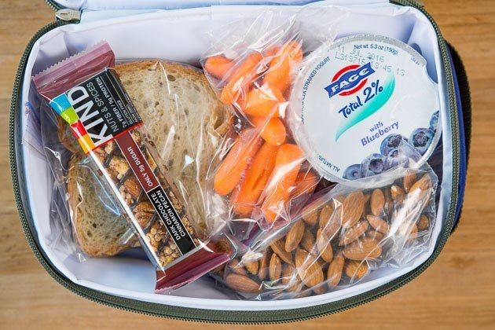
Healthy Lunches
How can we make our lunches healthier?
Add fruits and vegetables
  Apple slices, carrot sticks, celery, berries
You can keep chips, but add healthier options
  Sun chips (whole grains),
PB&J’S are a great source of protein!
  Sub wheat bread for white bread
Lunch meat sandwiches are good too
  Wheat bread, real cheese slices

Slide 13
Conclusion

